Slide 1
Natural User Interface(NUI)
By-Shirshak Upadhayay,181338

Slide 2
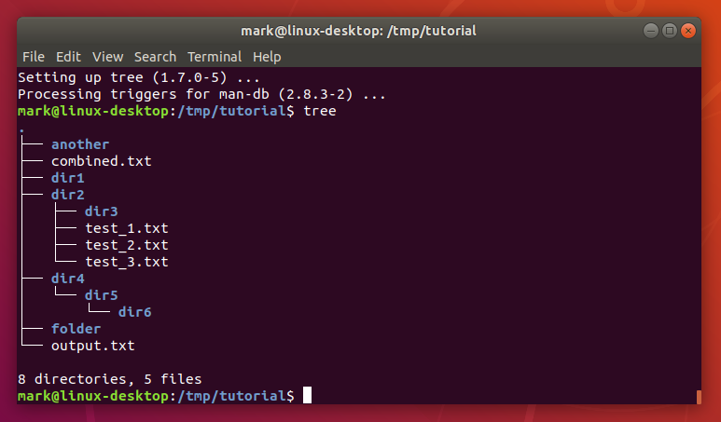
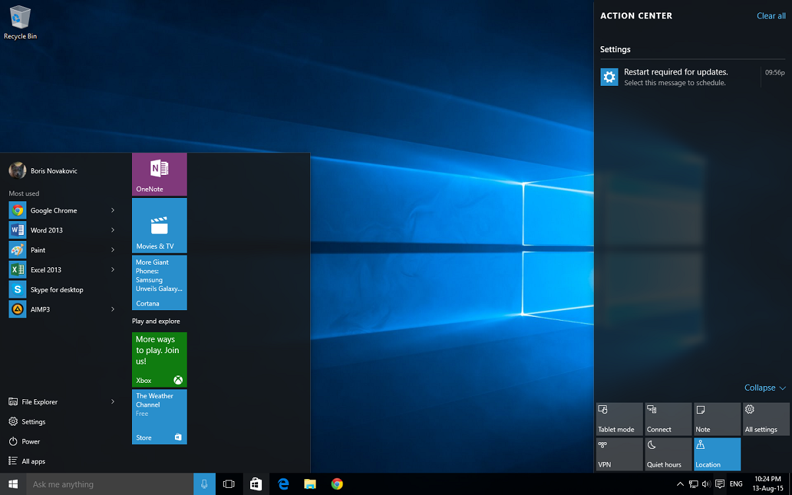
Traditional Approach
CLI – Command Line Interface
GUI-Graphical User Interface

Slide 3
Natural User Interface(NUI)
"Natural" refers to both action that comes naturally to human users,as well as the nature itself.
NUI is an invisible interfaces where the interaction is direct and consistent with our natural behaviour.
Traditional computer interfaces used artificial control devices whose operation has to be learned.

Slide 4
Examples of NUI
Touch Screen Interface.
Gesture Recognition.
Speech Recognition.
Brain-machine interface.

Slide 5


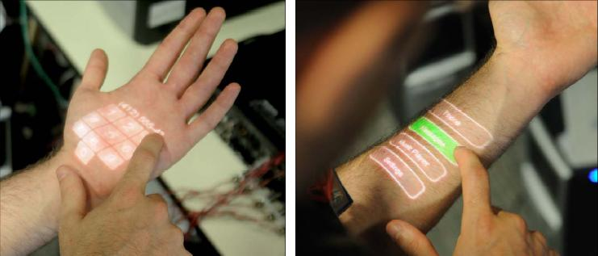
Touch Screen Interface
Lets user interact with controls and application more intuitively/directly than cursor based interface.
Instead of moving a cursor to select a file and clicking to open it,user touches the graphical representation of the file to open it.
Future-Skinput from Microsoft.

Slide 6
Gesture Recognition
Systems track user motions and translate those movements to instructions.
Nintendo Wii and PlayStation Move motion gaming systems work through controller-based accelerometers and gyroscopes to sense tilting, rotation and acceleration. Example-Microsoft Kinect for Xbox 360.
Speech Recognition
Allows users to interact with a system through spoken commands.
The system identifies spoken words and phrases and converts them to a machine-readable format for interaction.

Slide 7
Brain-machine Interface(BCI).
Reads neural signals and use programs to translate those signals into action.
BCI can make it possible for someone who is paralyzed to operate a computer, motorized wheelchair or prosthetic limb through thought alone.

Slide 8
Thankyou!!!

